Slide 1
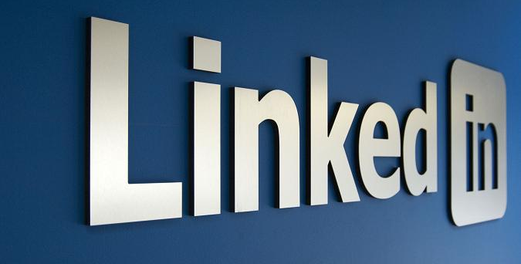

Slide 2
Speaker quick facts
Notes:
This section here should be used to establish WHY the speaker is the one presenting on this topic… Why are they a subject matter expert in this field…
WHY should the audience listen to them…

Slide 3
Why linked-in is important
Improve your visibility (make a name for yourself from day one and differentiate yourself from the crowd of other job or promotion seekers).
Linked in Answers are GREAT!
Improve your connect-ability (having a well filled out linked in profile will allow past colleagues to find and contact you).
Improve your page rank (will allow you to rank higher in Google when your name is searched).
Notes:
Linked in Answers is a relatively new feature on linked-in that allows professionals to seek answers to questions relating to business.
FOR YOU Linked-In should allow you to either help crowd source solutions to problems you may have and get known by other community members as a young person ACTIVELY trying to learn the ropes.
Showing a willingness to learn and use avenues like Linked-In can separate you from the crowd of other job seekers.
ALTERNATIVELY – If you know the answers to any questions, it’ll provide you with the opportunity to establish to the community that you’re a subject matter expert.

Slide 4
Steps to success
Step 1 – Establish WHO you are
Step 2 – Make a choice, LION or TPN
Step 3 – NETWORK!!!

Slide 5
Step 1
Who are you? - Your profile
Notes:
This step is where we will focus on filling out our profiles!

Slide 6
The good news!
We’re taking profile pics for you today!
Notes:
BU

Slide 7
Profile Pic – DON’Ts
Your profile pic should be you and YOU alone, NO group pics!
Too Sexy… NO cleavage, or hulking biceps
Too juvenile, NO cartoon pics
No movie pics, NO footy pics
Too staged, NO holding mobile phones, your tie etc.
Too random, NO landscapes, NO fruit
Too personal, NO baby’s, NO dogs
NO picture!
Notes:
While we’re taking your profile pic today, you WILL need to update as time goes on… so here’s the basic guidelines of what you need to do…

Slide 8
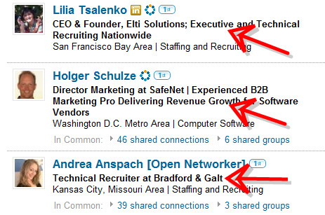
Have a HELPFUL Headline
In 120 Characters
Notes:
“I help x do y.”
Helping professional services firms attract more clients and win more new business
eCommerce and digital strategy guy for Gen Y
CEO and Software nerd at XYZ – Tells us that the person is also a techy at heart
Business focussed Information Security Architect

Slide 9
Why your headline shouldn’t be your current job
Your current job title probably doesn’t say much about what you do…
Consultant, Intern, Manager, Junior Analyst?
Treat your headline like your introduction when networking
How about something like:
Helping professional services firms attract more clients and win more new business
Notes:
Helping professional services firms attract more clients and win more new business
eCommerce and digital strategy guy for Gen Y
CEO and Software nerd at XYZ – Tells us that the person is also a techy at heart
Business focussed Information Security Architect
Pre-Sales Cloud Engineer vs Helping companies develop demo’s and prosposals for cloud computing clients

Slide 10
Questions to ask yourself
What do I provide businesses with?
What is my unique value proposition?
What is it that I actually do? Think more how you would describe what you do at work…
E.g I help companies develop a project from Initial idea to delivered product, providing PM along the way.
Notes:
Helping professional services firms attract more clients and win more new business
eCommerce and digital strategy guy for Gen Y
CEO and Software nerd at XYZ – Tells us that the person is also a techy at heart
Business focussed Information Security Architect

Slide 11
Your Summary
This is your chance at your very own elevator pitch
Be INTERESTING
No phrases that sound like an automatic mission statement generator!
No heavy jargon
Write in 1st person
Here, you should describe WHO you are and HOW you help people
Here are three steps to a successful summary
Notes:
Some people suggest that you should write your linked-in summary in third person, however if you write in this format your linked-in profile risks coming off as arrogant and pompous,
Our recommendation, stick to first person, yet still try to keep the “I” to a minimum!
Examples
Visual communications expert that helps B2B companies express their core value by making complex or abstract concepts easier to access, understand and remember. I design information, create visual stories and metaphors that quickly deliver succinct messages to key audiences.
Specialties
• Brand creation, Product launches: identity, design systems • Interactive design: info architecture / UI, web sites, applications • Visual design: web, applications, mobile, banners, • Telling stories: investor, sales, marketing and educational presentations. • Animations explaining Life Science or Technology concepts • Icons and infographics (visual diagrams explaining processes, value, statistics, or relationships) • Print: marketing and educational tools, trade show displays

Slide 12
3 Steps to a successful summary
Step 1: Introduce WHO you are. Talk about HOW you’ve got to where you are today and WHERE you are.
Step 2: Talk about WHO your clients/employers are, what type of company do you help, do you work for IB, do you work for consultancies.
Step 3: WHAT do you do, talk about what you do for these companies.

Slide 13
Use your name as the unique url
Linked-In allows you to set a custom linked in url, set it as your full name so you rank better in search.

Slide 14
Recommendations
Recommendations are social proof, that businesses look at to see if you’ve impressed previous employers/clients.
Try not to ask people for recommendations, better strategy is to leave a recommendation for people you would vouch for… quid pro quo, they’ll be inclined to help out in response.
Notes:
Linked In will ask people when they get a recommendation if they would like to respond to the recommendation.
Go through what they should say:
Phrase your recommendation according to the level of recommendation you are giving… don’t say highly recommend if you havnt worked with them on multiple projects and had consistently high results…
Explain what you recommend them for
Why you recommend them
Who they can help AND
Who they have already helped

Slide 15
Completing your profile
Linked-In provides some great insights into how you can fill out all the foundations of your profile. You should follow Linked-In prompts to get to 100% completion.
When asked to describe what you did at a particular jobs, where possibly try to include quantifiable achievements such as:
Built from Idea to final event, BiG Day In, IT Student Careers conference with 220 attendees within 3 Months
Notes:
So based on all of that… here what you should have when you put it all together…!

Slide 16
Putting it all together
Profile Pic
Headline
Summary
If possible Current and 2+ Previous work experiences
URL
Recommendations
Notes:
Recommendations, give to get, just don’t look like they’re all tit for tat as that’ll make your profile look very

Slide 17
Step 2
Make a choice

Slide 18
LION
Trusted Partner
Linked-In Open Networker
Trusted partner networking
Notes:
Explain here what trusted partner networking is
Only adding people you know… People you’ve done business with
Using linked in to keep in touch with your existing circle of business associates only.
Linked In Open Networker
A linked-in open networker ACTIVELY adds people on linked in for the purpose of increasing the size of their network and ACTIVELY
engages with this broad community, LIONs regularly have 500+ connections and will frequently spend time on linked in networking with their connections.
This may include introducing connections, recommending people, and seeking recommendations.
Somewhere in between is where a lot of people go… accepting ads from people they don’t know, but not actively adding people…
WHAT IS REALLY IMPORTANT is that you really cultivate your connections and maintain or develop relationships with them!...
We’ll get into that in the next step

Slide 19
Step 3
Network

Slide 20
What to do with all those connections
Status updates subtly remind your contacts of what you do.
Just pitched Queensland government on the benefits of tech in curriculum
Just finished an extensive IT audit, proud of the team.
Team just finished evangelising Microsoft at the TechEd conference!
Watch others status updates and respond where possible to initiate contact.
Notes:
Be sure to ensure that you don’t share ANY confidential info.
Worst thing you can do is make public that it was your company auditing something or that found something… if its not already public knowledge…

Slide 21
Linked-In Donts
Overshare! - “aT the baR til 4AM!!!”
Harass others – Hey can you give me the CEO’s number? Hey can you review my resume.
Overuse words: Creative, organisation, effective, extensive experience and track record.
Post inappropriate photos
Neglect profiles and update
Notes:
Those words are the most OVERUSE

Slide 22
One more thing
Review your LinkedIn profile. Look at it as if you’re a prospective new boss, or a client. Would you hire YOU to do something? If not, rewrite it. Keep it tight. Do as much editing as you can.

